Slide 1

AMRITA VISWA VIDYAPEETHAM
AI AND EDGE COMPUTING
END SEM PROJECT
PRESENTATION

Slide 2

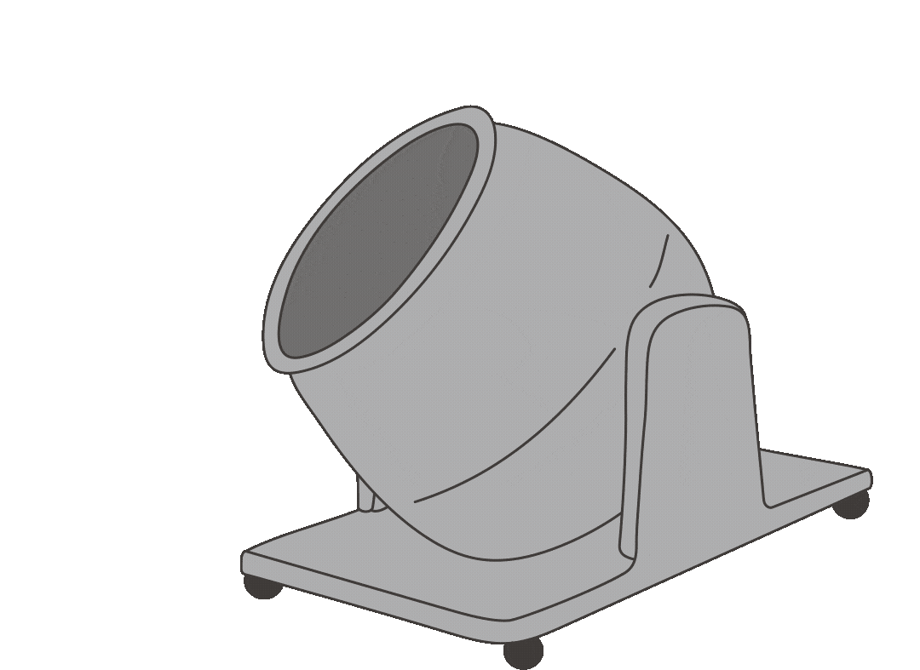
WATER
QUALITY TEST PREDICTION FOR CONCRETE MIXING

Slide 3








PRESENTED BY
D Sai Pavan - CB.EN.U4ELC22011
A Kalyan - CB.EN.U4ELC22004
V Kiran - CB.EN.U4ELC22065
A Samanvay - CB.EN.U4EEE22157

Slide 4
INTRODUCTION
CONCRETE IS A BASIC BUILDING MATERIAL USED EXTENSIVELY IN INFRASTRUCTURE, BUILDINGS, AND OTHER STRUCTURAL USES.
CONCRETE QUALITY IS INFLUENCED BY THE NATURE OF CEMENT, AGGREGATES, AND WATER EMPLOYED IN THE MIXING PROCESS.
WATER HAS A SIGNIFICANT INFLUENCE ON THE STRENGTH, DURABILITY, AND WORKABILITY OF CONCRETE.
POOR-QUALITY OR CONTAMINATED WATER MAY RESULT IN LOW BONDING STRENGTH, HIGHER POROSITY, AND LONG-TERM STRUCTURAL DETERIORATION.

Slide 5

Problem Statement
➢ Water quality is a crucial component in the concrete mixing process, as the quality of the water used can have a significant impact on the strength and durability of the final concrete product
➢ Inaccurate water quality testing process can lead to a weaker and less durable final product, resulting in costly repairs and replacements

Slide 6
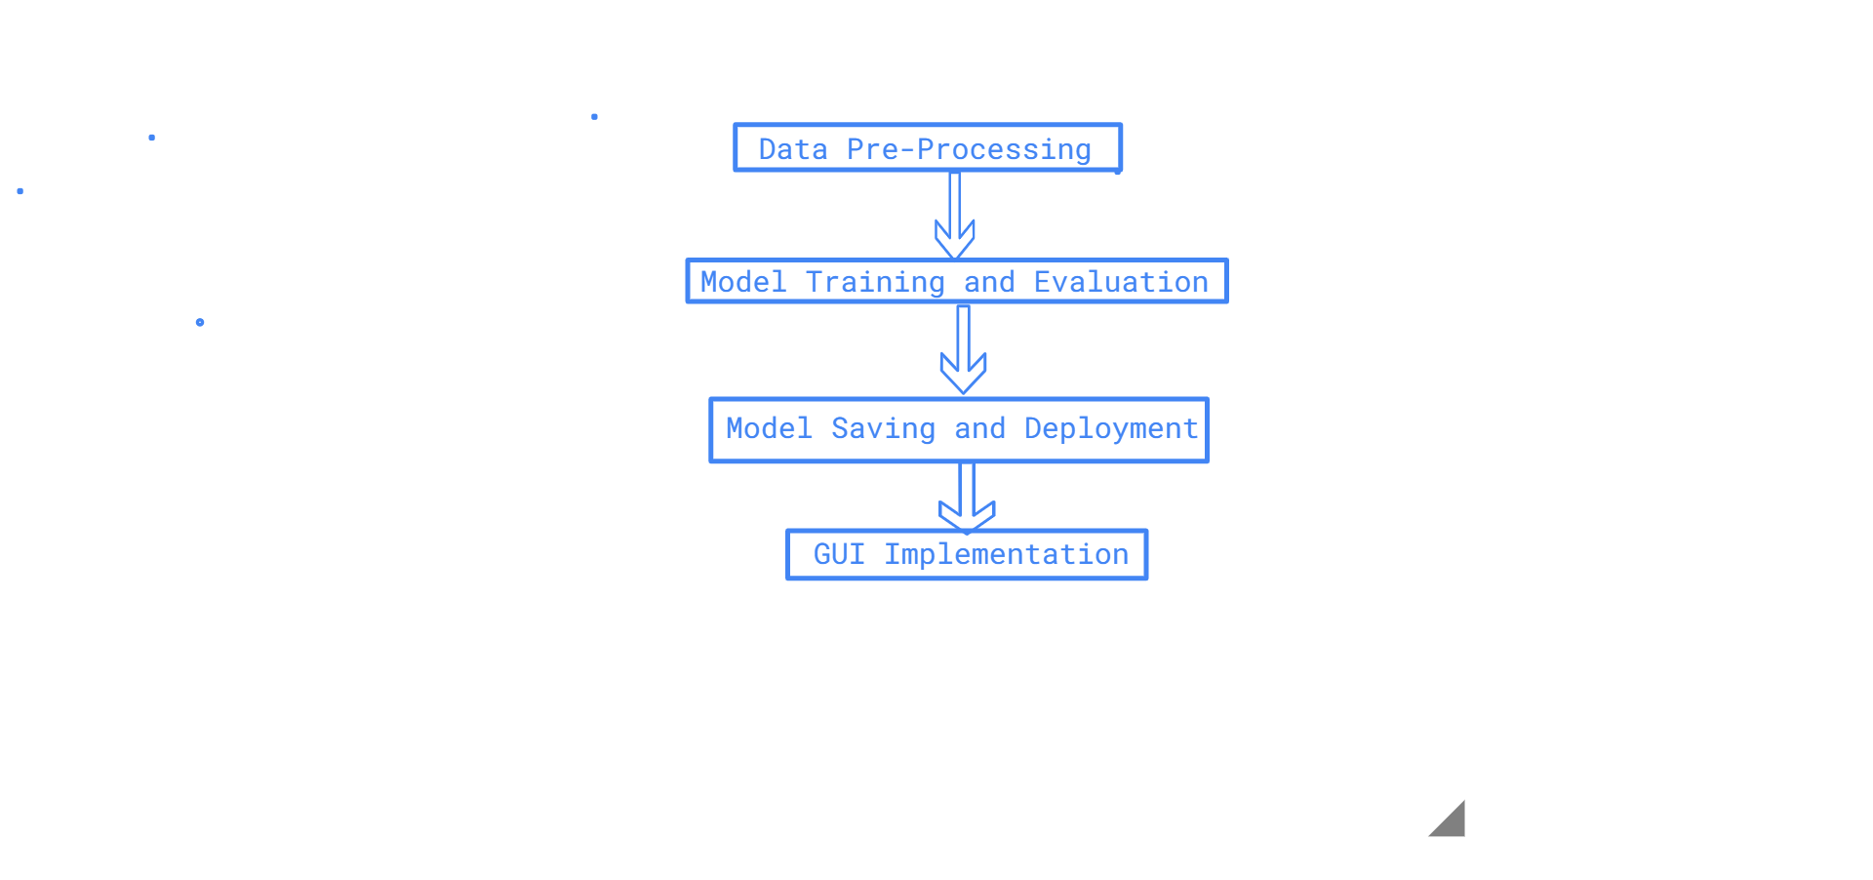
Methodology
1: Data Preprocessing
Start → Load Dataset → Handle Missing Values → Normalize & Scale Data → Split into Training & Testing Sets
2: Model Training & Evaluation
Train XGBoost, ANN, Random Forest, SVM → Evaluate using Accuracy, Precision, Recall, F1-score, Sensitivity, Specificity → Compare Model Performance
3: Model Saving & Deployment
Save Best Model using Joblib/Pickle → Integrate with PyQt5 GUI
4: GUI Implementation (PyQt5)
User Inputs Water Quality Parameters → Select Model from Dropdown → Predict Good/Bad Water Quality → Show Metrics & Graph

Slide 7

Understanding Dataset
Why is the Dataset Important?
Before applying Machine learning model, First we need to analyse the dataset.
Exploratory Data Analysis is Done.
Understand the dataset’s structure.
Identify missing values, outliers, and incorrect data types.
Detect data inconsistencies (e.g., negative values in weight columns).
Prepare the dataset for data cleaning and feature engineering.

Slide 8


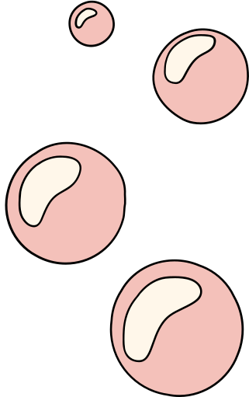
DATASET FEATURES
pH – Measures acidity/alkalinity of water. (Ideal: 6-8)
Chloride (Cl⁻) – Excessive chloride can corrode steel reinforcement.
Organic Carbon – Indicates contamination from organic materials.
Solids – Measures dissolved and suspended particles.
Sulphate (SO₄²⁻) – High levels cause concrete deterioration.
Turbidity – Measures cloudiness due to suspended particles.
Target Variable (Output):
Good Water (1) – Suitable for concrete mixing.
Bad Water (0) – Not suitable due to impurity levels.

Slide 9
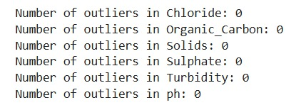
EDA Analysis RePORt
OUTLIER DETECTION USING IQR
The Interquartile Range (IQR) method is used to detect outliers.
Steps:
Calculate the 25th percentile (Q1) and 75th percentile (Q3) of the feature.
Compute the IQR = Q3 - Q1 (spread of the middle 50% of data).
Define the lower bound and upper bound:
Lower Bound = Q1 - 1.5 × IQR
Upper Bound = Q3 + 1.5 × IQR
Any value below the lower bound or above the upper bound is considered an outlier.
Boxplots are plotted for visualizing outliers

Slide 10
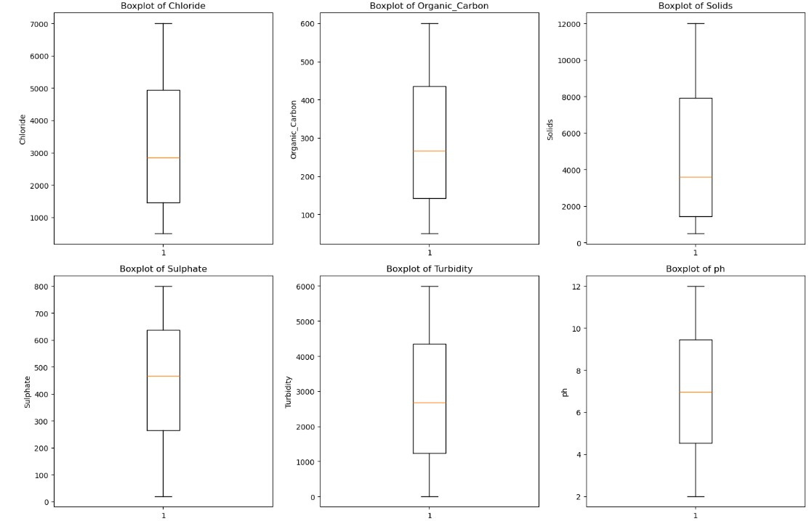

Slide 11
Correlation Analysis
How it Works?
The Pearson correlation coefficient is calculated between numerical features.
The correlation matrix shows how strongly features are related (1 = perfect positive correlation, -1 = perfect negative correlation, 0 = no correlation).
A heatmap is used for easy visualization.

Slide 12
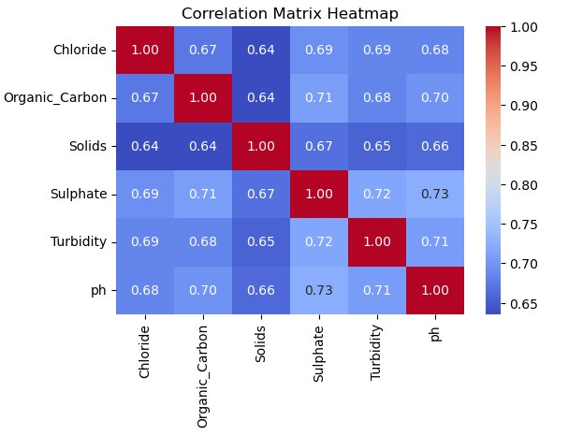
Corelation Analysis Output
Correlation analysis helps identify dependencies between features, which can improve feature selection.

Slide 13
Conclusion Of Data Analysis
The dataset is well-structured with no outliers.
Feature correlation is high
You can proceed to model training with confidence.

Slide 14
DATA PREPROCESSING

Slide 15
Load dataset 📂
Remove unnecessary columns
Define features (X) and target (y)
Normalize features using MinMaxScaler()
Save the scaler for future use For GUI
Split data into training & testing sets (80-20%)

Slide 16
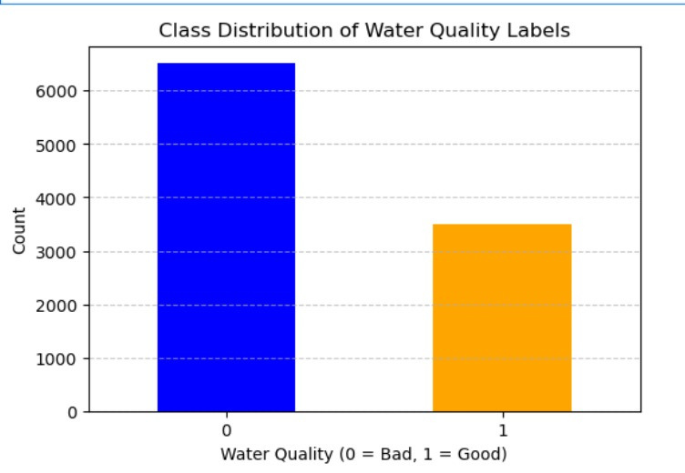
Distribution of the Target Variable

Slide 17
MODEL TRAINING

Slide 18
XGBoost Model
A powerful ensemble learning method.
Uses multiple decision trees with boosting to improve accuracy.
Works well with structured data.
Handles missing values efficiently.

Slide 19
Random Forest Model
Random Forest - Ensemble of Decision Trees
Uses multiple decision trees for classification.
Reduces overfitting by random feature selection.
Works well with non-linear relationships.

Slide 20
Support Vector Machine (SVM)
Finds an optimal boundary (hyperplane) between classes.
Uses kernel trick for complex decision boundaries.
Works well with high-dimensional data.

Slide 21

ARTIFICIAL NEURAL NETWORKS
An Artificial Neural Network (ANN) is a machine learning model inspired by the human brain, designed to recognize patterns and make predictions. It consists of layers of neurons that process and transform data.

Slide 22
ARTIFICIAL NEURAL NETWORKS LAYERS
Input Layer shape=(X_train.shape[1],) -----------------Number of features in input data
Hidden Layers- 10 hidden layers
Neurons per Layer-256 → 128 → 64 → 64 → 32 → 32 → 16 → 16 → 8 → 8
Activation Function ReLU (hidden layers)-- Prevents vanishing gradient, improves non-linearity
Output Layer 1 neuron, Sigmoid Binary classification (output between 0 and 1)

Slide 23
ARTIFICIAL NEURAL NETWORKS LAYERS
Batch Normalization-- applied after first dense layer-- Stabilizes activations and speeds up training
Dropout 0.3-- Drops 30% of neurons randomly per iteration to prevent overfitting
Optimizer Adam Adaptive learning rate optimization
Learning Rate 0.0005 Controls step size for weight updates (smaller = stable but slower)
Loss Function binary_crossentropy Suitable for binary classification
Metrics accuracy Measures classification performance

Slide 24
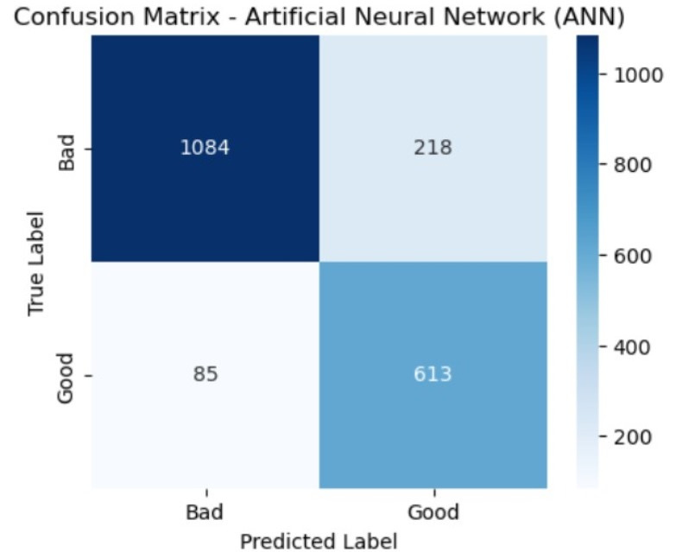
PERFORMANCE METRICS
Accuracy -84.85%
Precision - 0.7377
Recall - 0.8782
Specificity - 0.8326
F1-score - 0.8018
ANN Confusion matrix

Slide 25
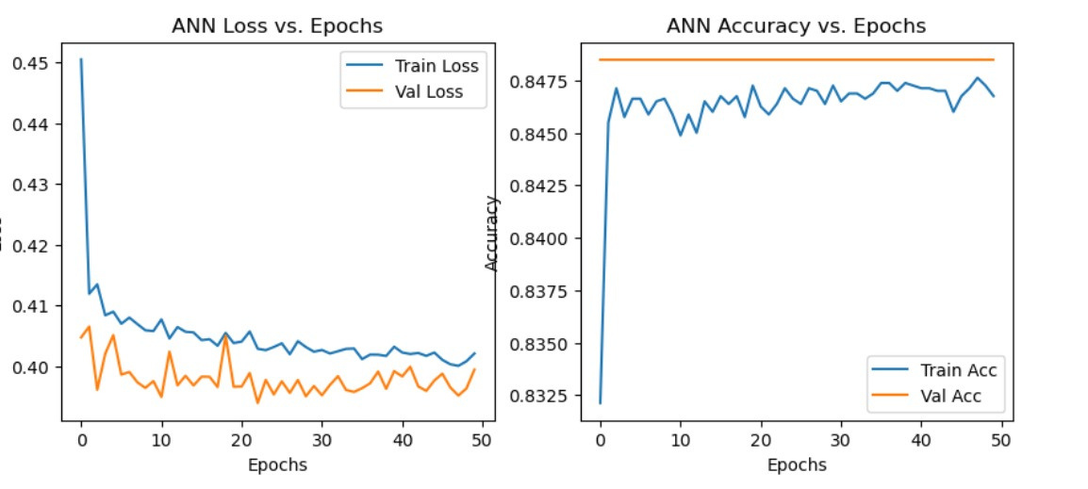
ACCURACY AND LOSSES

Slide 26

Conclusion
The comparison of different machine learning models for water quality prediction emphasizes the advantages and disadvantages of each method. On the basis of accuracy, recall, and overall performance, SVM and ANN models are the best options for this classification task. Their high recall values indicate that they are extremely efficient in identifying cases of poor water quality, which makes them especially valuable in scenarios where failing to detect such cases could have serious implications.

Slide 27

BEST MODEL BASED ON ACCURACY
ANN

Slide 28
FUTURE WORK
Improve dataset with more parameters.
Deploy as a web-based tool.
Integrate IoT sensors for real-time monitoring.

Slide 29


